Slide 1
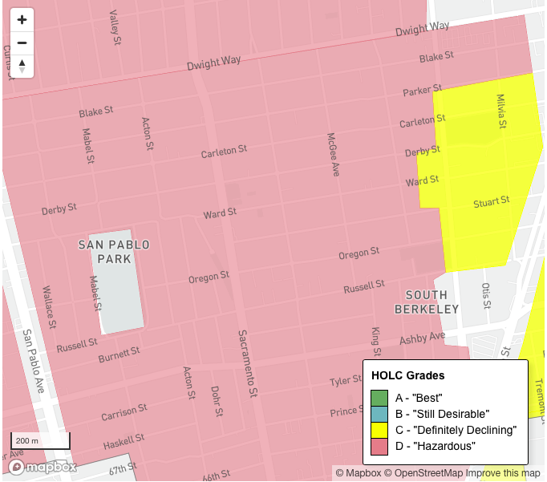
A Survey of the South Berkeley Neighborhood: The 1940’s onward
BOUNDARIES OF THE NEIGHBORHOOD SURVEY:
N
Dwight Way
W E
San Pablo Avenue Martin Luther King Jr. Way
S
Alcatraz Avenue
This map image outlining the redlined zone in South Berkeley is used from a 2018 Berkeleyside article. Article can be found on references page.
A survey by Gina Raquel Wright
May 2021

Slide 2
The Narrative Portion
My feet were tired after spending the afternoon walking around South Berkeley with my Uncle Danny on a warm day in early July last year. Tired feet were a very small price when my body and mind had been blessed with his shared personal narratives and experiences of growing up in that area.
His life began there in the mid 50’s ­– he remembers the time when the Santa Fe Railroad ran through the neighborhood, right through Parker St. and Carleton St. He told me about playing baseball at San Pablo Park when he was a child with his friends – it was nice to see his face light up with a smile as the small beads of sweat collected on his forehead. Uncle Danny said this is where all the black kids played. He would meet up with his friends and neighbors when he could, and they’d get a good game going. He told me about almost all of his neighbors being black – this was a distinctly black neighborhood. Given the history of zoning in Berkeley, especially West and South Berkeley, this was no surprise.
The Bay Area, like most other metropolitan areas in this country, was subjected to discriminatory practices of redlining by Federal Housing Association (FHA) and the Home Owners Loan Corporation (HOLC) starting in the 1930s (Barber 2018; Moore et al 2019, p. 11). For black folk in the East Bay, and specifically Berkeley in the case of this survey, this meant that they were deemed to live in what was understood as a “hazardous” zone or neighborhood – the least desirable place to be within a city. They weren’t typically accepted or approved to live elsewhere. For the large number of black folk who had recently migrated to the area from southern states with hope for a better livelihood and income, which was the common idea for black folks in light of the WWII war-time economy and industry in the Bay Area in the 1940’s (Cuahutémoc), now found themeselves forced to live in these “hazardous” red zones. This caused for the movement of thousands of black people to South Berkeley in the 40’s (Barber 2018).
1

Slide 3
The practice of discriminatory redlining is predictable behavior given the violent history of how people of African descent were (and are) treated by the dominant control of the White human in this country. In connection to the discriminatory practice of redline against black folk and as Tiffany King succinctly writes, “the space and place of the White human is established not by embodied and physical representation but through a signification system composed of text, grid lines, the logocentric and geometric symbols that establish subjectivities with cartographic authority though the symbols of property possession.” (King 2019, p. 87). In that way “whiteness is present (without being presented) as ‘order, civilization, and logos’” (King 2019, p. 89).
Many black folks in the neighborhood were against practices of redlining and housing discrimination. They weren’t going to allow this to be the status-quo and William Byron Rumford, a member of the community, local pharmacist, and the first black person elected to the Legislature from the Bay Area, made it a priority of his to fight for the fair housing law in California (Rumford Act), which indeed went through and passed in 1963. Foreseeably, there was a lot of resistance from white folks as they didn’t want any repeals to a housing law that segregated space, gave discriminatory loans, and prompted their comfortability (Moore et al 2019, p. 13; p.54).
In addition to the movement in the neighborhood around fair housing and anti-discrimination, there was also a narrative of self-contained survivability coursing through the streets; this predominantly black neighborhood and community supported and provided one another (Barber 2018). There were several black-owned businesses up and down Sacramento St. where people of the community could generate financial support for their people. One distinct business location on Sacremento was “Reid Records,” a music store that was known for their selection of gospel music – a style of music very prominent within black community. Similar to how Cruz-Manjarrez speaks about Yalalteco community and their bailes in L.A, the music Reid records has in stock as a black-owned business provides a cultural tether for black folks who face isolation from the dominant society. Although closed, the building that housed Reid Record’s remains to this day. Nevertheless, it provides itself as a useful site in remembering black-owned businesses in that area and its culture.
2

Slide 4
As the afternoon went on, Uncle Danny shared with me about how a number of older black people in the area got cancer and had compromised hearing. “The railroad?” I asked. Of course, it had been the railroad. It ran through the neighborhood for decades, bringing in tons of people from the South for work. As noted by Soskin in her memoir, “coming in by thousands on these trains, passed in our front door, day after day,” (Soskin 2017, p.46). Unfortunately, the operation and decades-long use of the railway polluted and poisoned its surroundings. Now there is distinct effort from people in the community to restore the harmed land and make healthful use of it once again (i.e. recreational green spaces, community gardens, and walking paths (Woods 2020).
I had not known the neighborhood in the same way that Uncle Danny did – I mean, how could I? He’s over 40 years my senior. It’s true that my eyes had previously been exposed to that neighborhood. However, prior to that afternoon we spent together I hadn’t really seen the neighborhood. There were clues, material markers, everywhere that told a story of how this neighborhood once moved and continues to move. With the material markers, such as the unchanged architecture of homes that used to house black industrial workers, the empty, poisoned plots where the Santa Fe Railroad used to run through, or the large mural of Rumford on Sacramento St., alongside the narrative that Uncle Danny shared, I was blessed with what felt like a distinct truth-telling about how the past flowed here. I felt fortunate to have the living breathing archive of histories and past experiences that came from Uncle Danny. Contrary to the tomb that Hartman speaks of that often exists when the multiplicities of stories from colonized people are lost, forgotten, or never heard, it felt like the narratives Uncle Danny shared existed in a cradle – his personal stories and connected histories passed on to the next generation – me – to be protected, remembered, cared for, and shared.
3

Slide 5
References and Acknowlegements
Barber, Jesse. 2018.“Redlining: the history of Berkeley’s segregated neighborhoods,” Berkeleyside. https://www.berkeleyside.com/2018/09/20/redlining-the-history-of-berkeleys-segregated-neighborhoods.
Cruz-Manjarrez, Adriana. 2013. Zapotecs on the Move: Cultural, Social, and Political Processes in Transnational Perspective. Rutgers University Press. Chapter 1: “The Yalaga Zapotecs: A Town of Immigrants”; Chapter 2: “Building Community and Connections in Los Angeles”; Chapter 3: “Community Life Across Borders”, pp. 20-96.
Cuahutémoc Arroyo, "Jim Crow" Shipyards: Black Labor and. Race Relations in Easy
Bay Shipyards During World War II, Ferris State University, http://www. ferris.edu/jimcrow/
liiiks/misclink/shipyards.htm (last visited May 10, 2021)
Dougherty, Conor, 2019 “Overlooked No More: William Byron Rumford, a Civil Rights Champion in California.” The New York Times. https://www.nytimes.com/2019/08/07/obituaries/william-byron-rumford-overlooked.html
Hartman, Saidiya. 2008. Venus in Two Acts. Small Axe 12 (2), pp. 1–14.
King Lethabo, Tiffany. 2019. The Black Shoals: Offshore Formations of Black and Native Studies. Durham, NC: Duke University Press, “The Map (settlement) and the Territory (The Incompleteness of Conquest)”, pp. 74-111.
Moore, Eli, Nicole Montojo, and Nicole Mauri. 2019. Roots, Race, & Place: A History of Racially Exclusionary Housing in the San Francisco Bay Area. pp. 10-15; 54-56.
Reid-Soskin, Betty. 2018. Sign My Name to Freedom: A Memoir of a Pioneering Life. New York: Hay House, “
Wood, Cirrus. 2020. “Group aims to ‘green’ South Berkeley by transforming old railroad right-of-way,” Berkeleyside. https://www.berkeleyside.org/2020/01/06/group-aims-to-make-south-berkeley-greener-by-transforming-the-old-railroad-right-of-way
I was inspired to return to this neighborhood for this project as that walk with my Uncle last summer really left a lasting impression on me. It was a joy to go back and photograph some of the sites that we spent so much time talking about last year. I hope that you enjoy the photographic portion of this project.
*next page plays music, so be mindful of that

Slide 6

THE PHOTOGRAPHIC ARCHIVE PORTION
Take yourself on a virtual tour of photos from the South Berkeley neighborhood that the narrative portion bases itself on. The. boundaries of this neighborhood survey are North: Dwight Way;South:Alcatraz Avenue; West: San Pablo Avenue; East: MLK Way
Photography by Gina Raquel Wright
Featuring One Old Archival Photo
Music by Dorothy Ashby

Slide 7
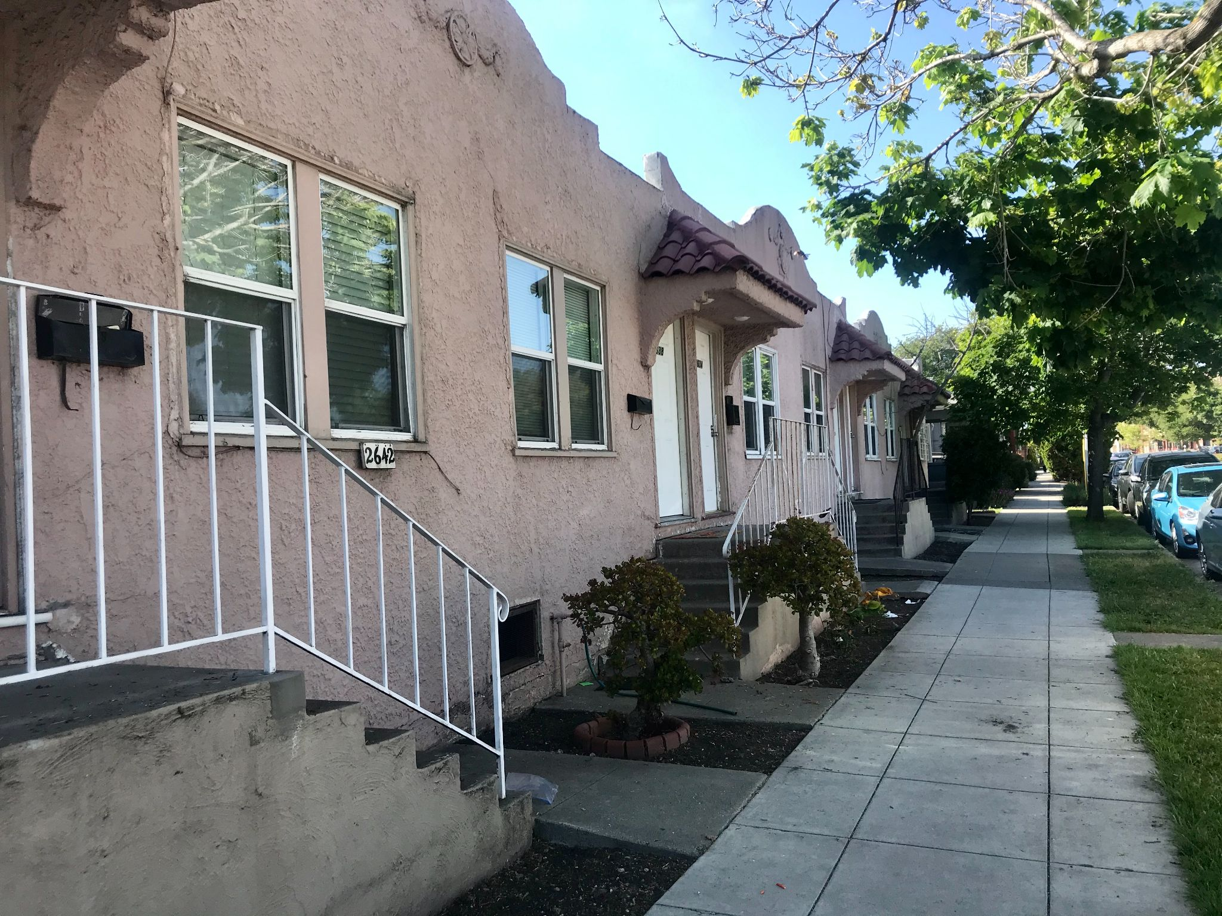
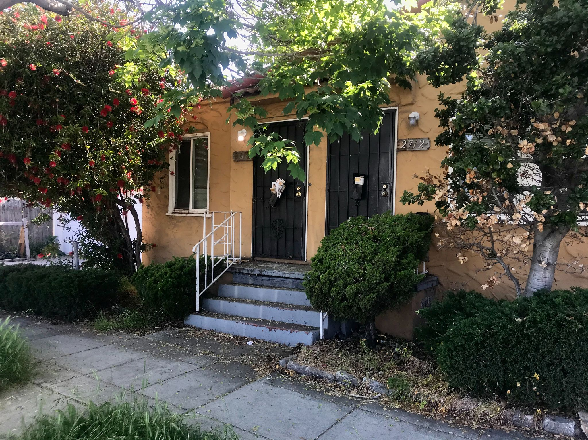
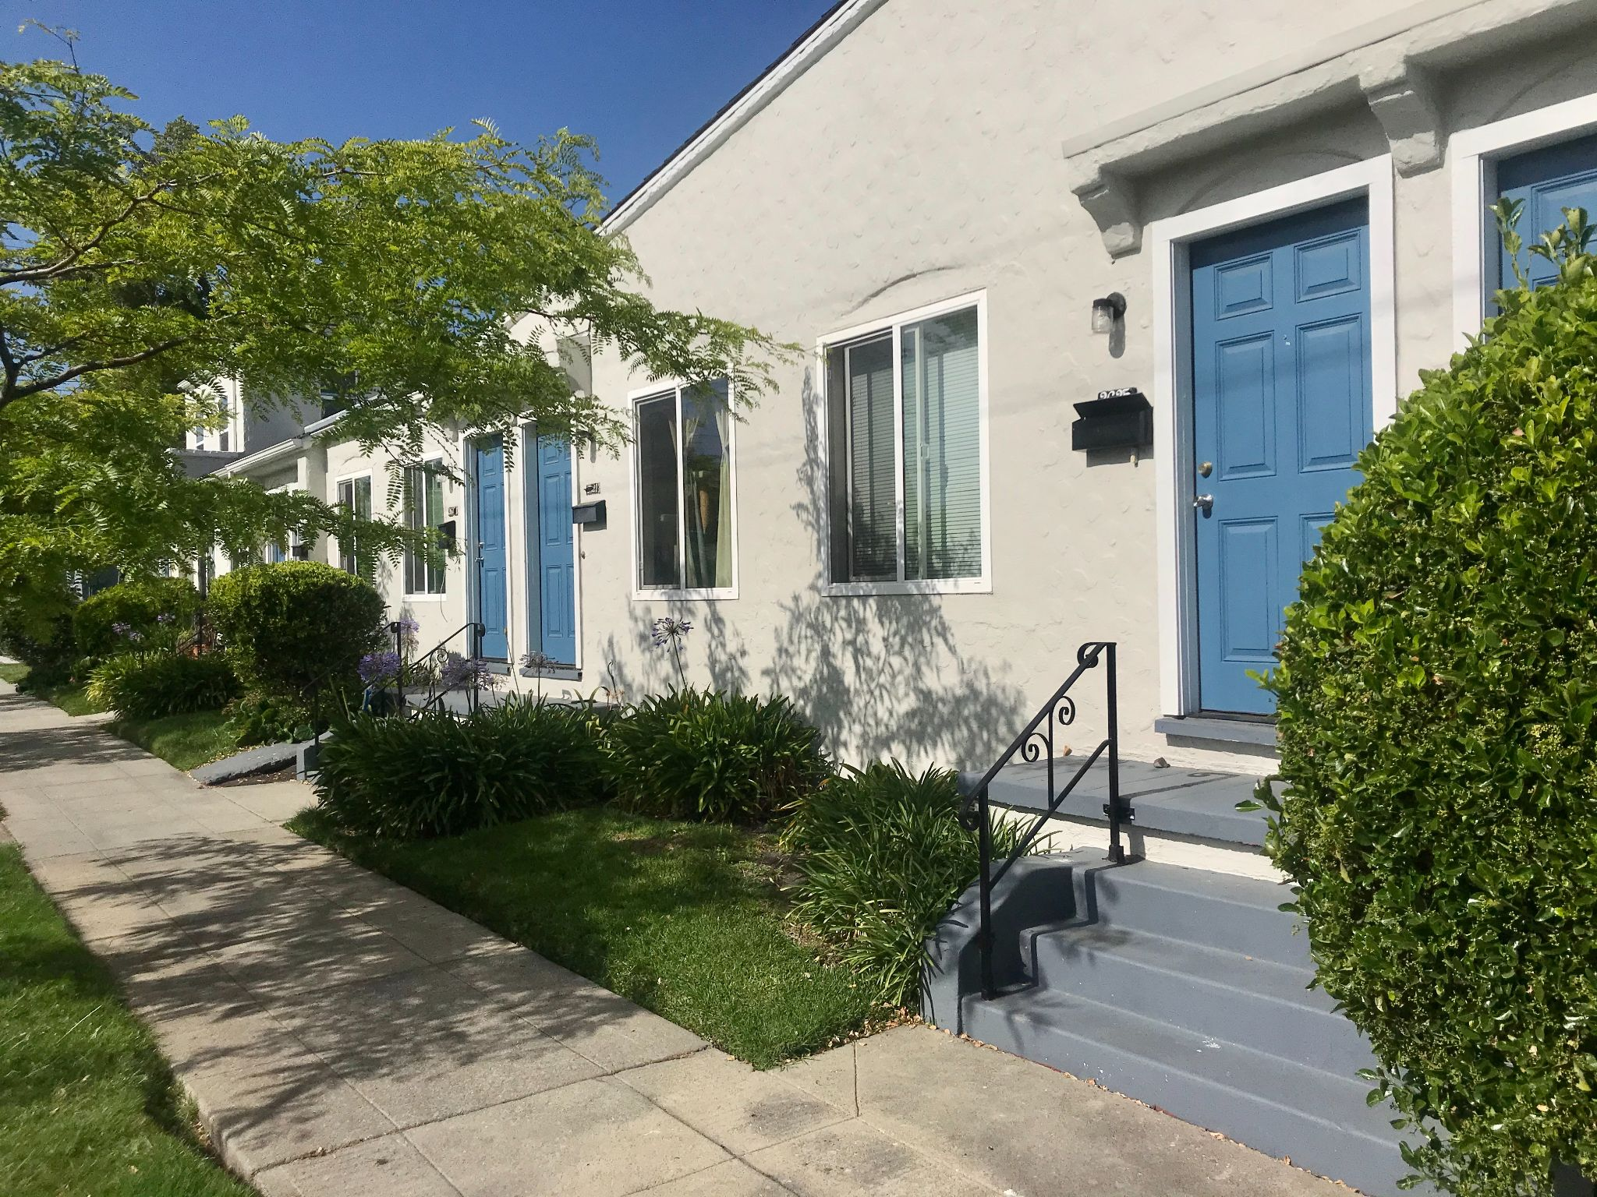
HOUSING FOR WWII & OTHER INDUSTRIAL WORKERS
This style of housing dominates the blocks of Sacramento Street in Berkeley, CA, especially between the blocks of Dwight Way and Alcatraz Avenue.
.If you look closely you’ll notice that the doorsteps lead to two doors. Those two doors lead to two separate, tightly spaced living units, or quarters. The architecture of these homes clues us into to what type of people it was housing and around the time frame it was built.
These homes were known to house World War II industry workers who were predominantly black. They were constructed in the early 40’s to meet the demand for housing as thousands of people, particularly black folk, who were coming for the southern states to work in California at the shipyards or within other war time industries during the time of WWII (Soskin 2018; Moore 2019).

Slide 8
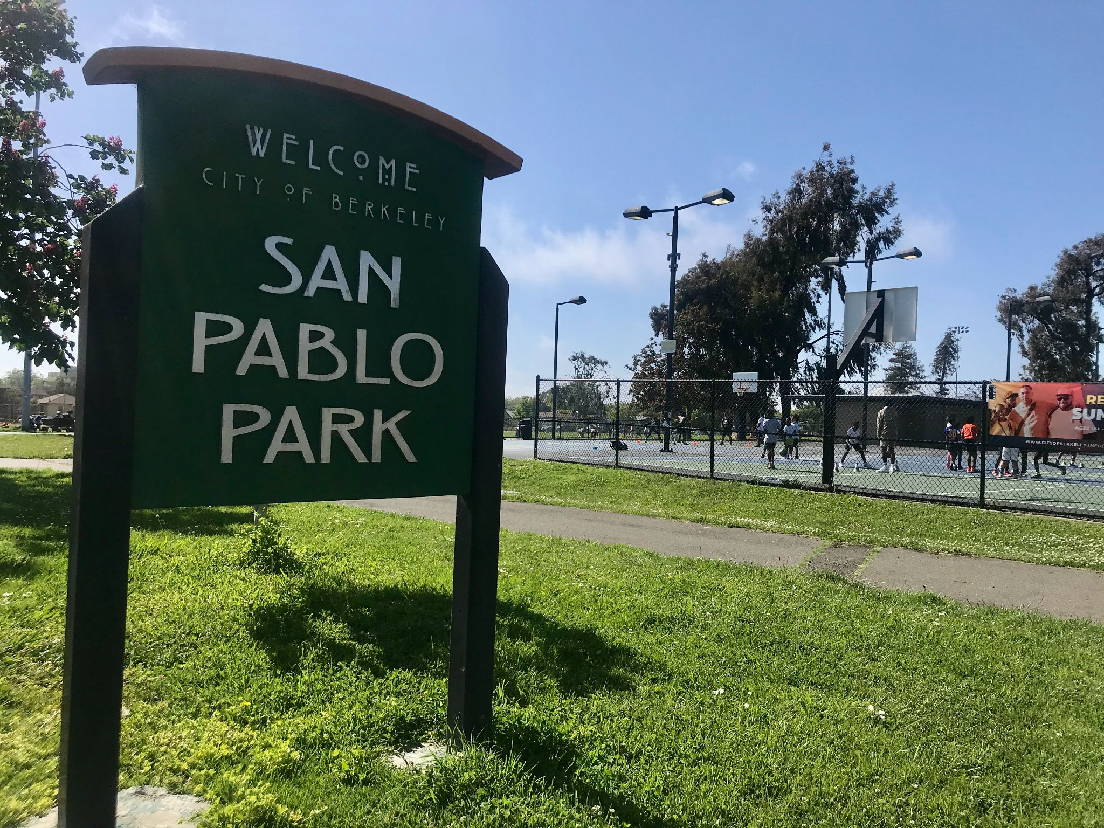
San Pablo Park was a major park for the black community in this neighborhood during the mid-late 19th century. As this area of Berkeley was pretty segregated away from other, whiter neighborhoods, many black children found themselves spending time here with their friends and neighbors of the community. Baseball and football were popular games to play here during the mid-19th century (Soskin 2018). The park has been remodeled since the mid-1960’s including both a basketball courts and a baseball field. Today, at least upon my few visits, it seemed to be pretty culturally and racially diverse. There were tons of people engaged in different activities. From basketball to baseball or lounging to hopping around the playground, San Pablo Park has space for all walks of life.

Slide 9
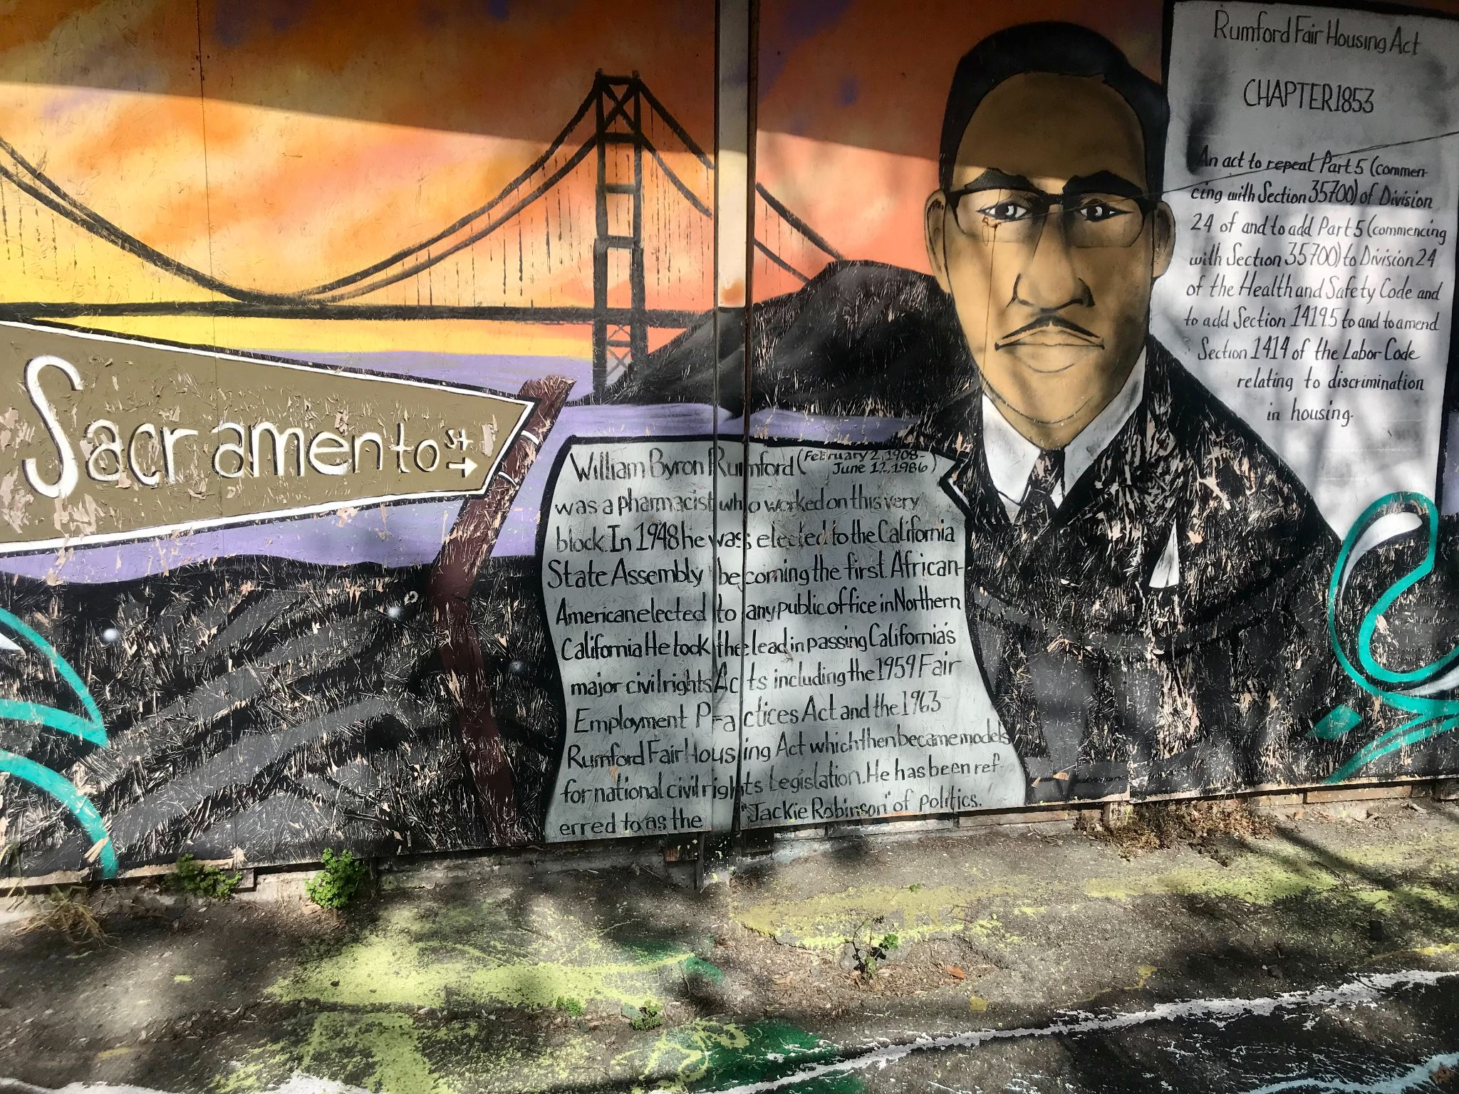
This is a mural of William Byron Rumford found on Sacramento St. just across the street from the statue of Rumford. This man was a fundamental person in pushing for fair housing policy in California. His community and neighborhood in his adulthood was that out South Berkeley, hence all the public art representation of him.

Slide 10
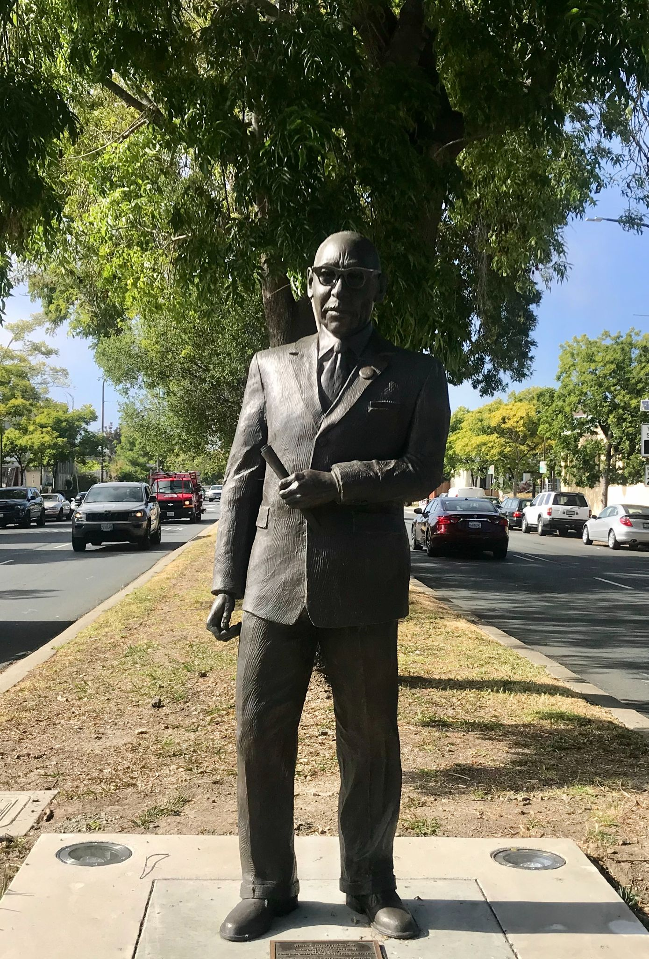
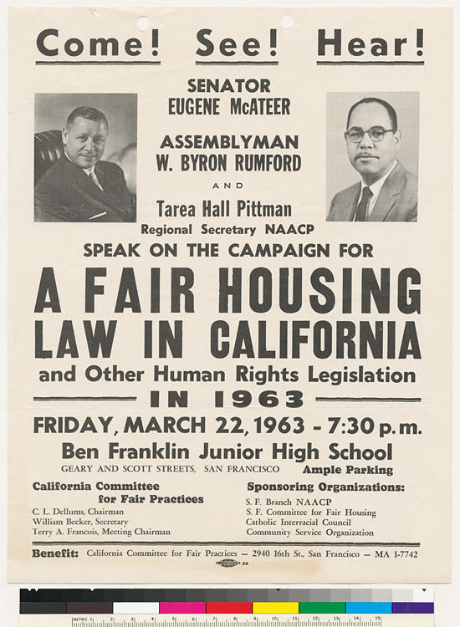
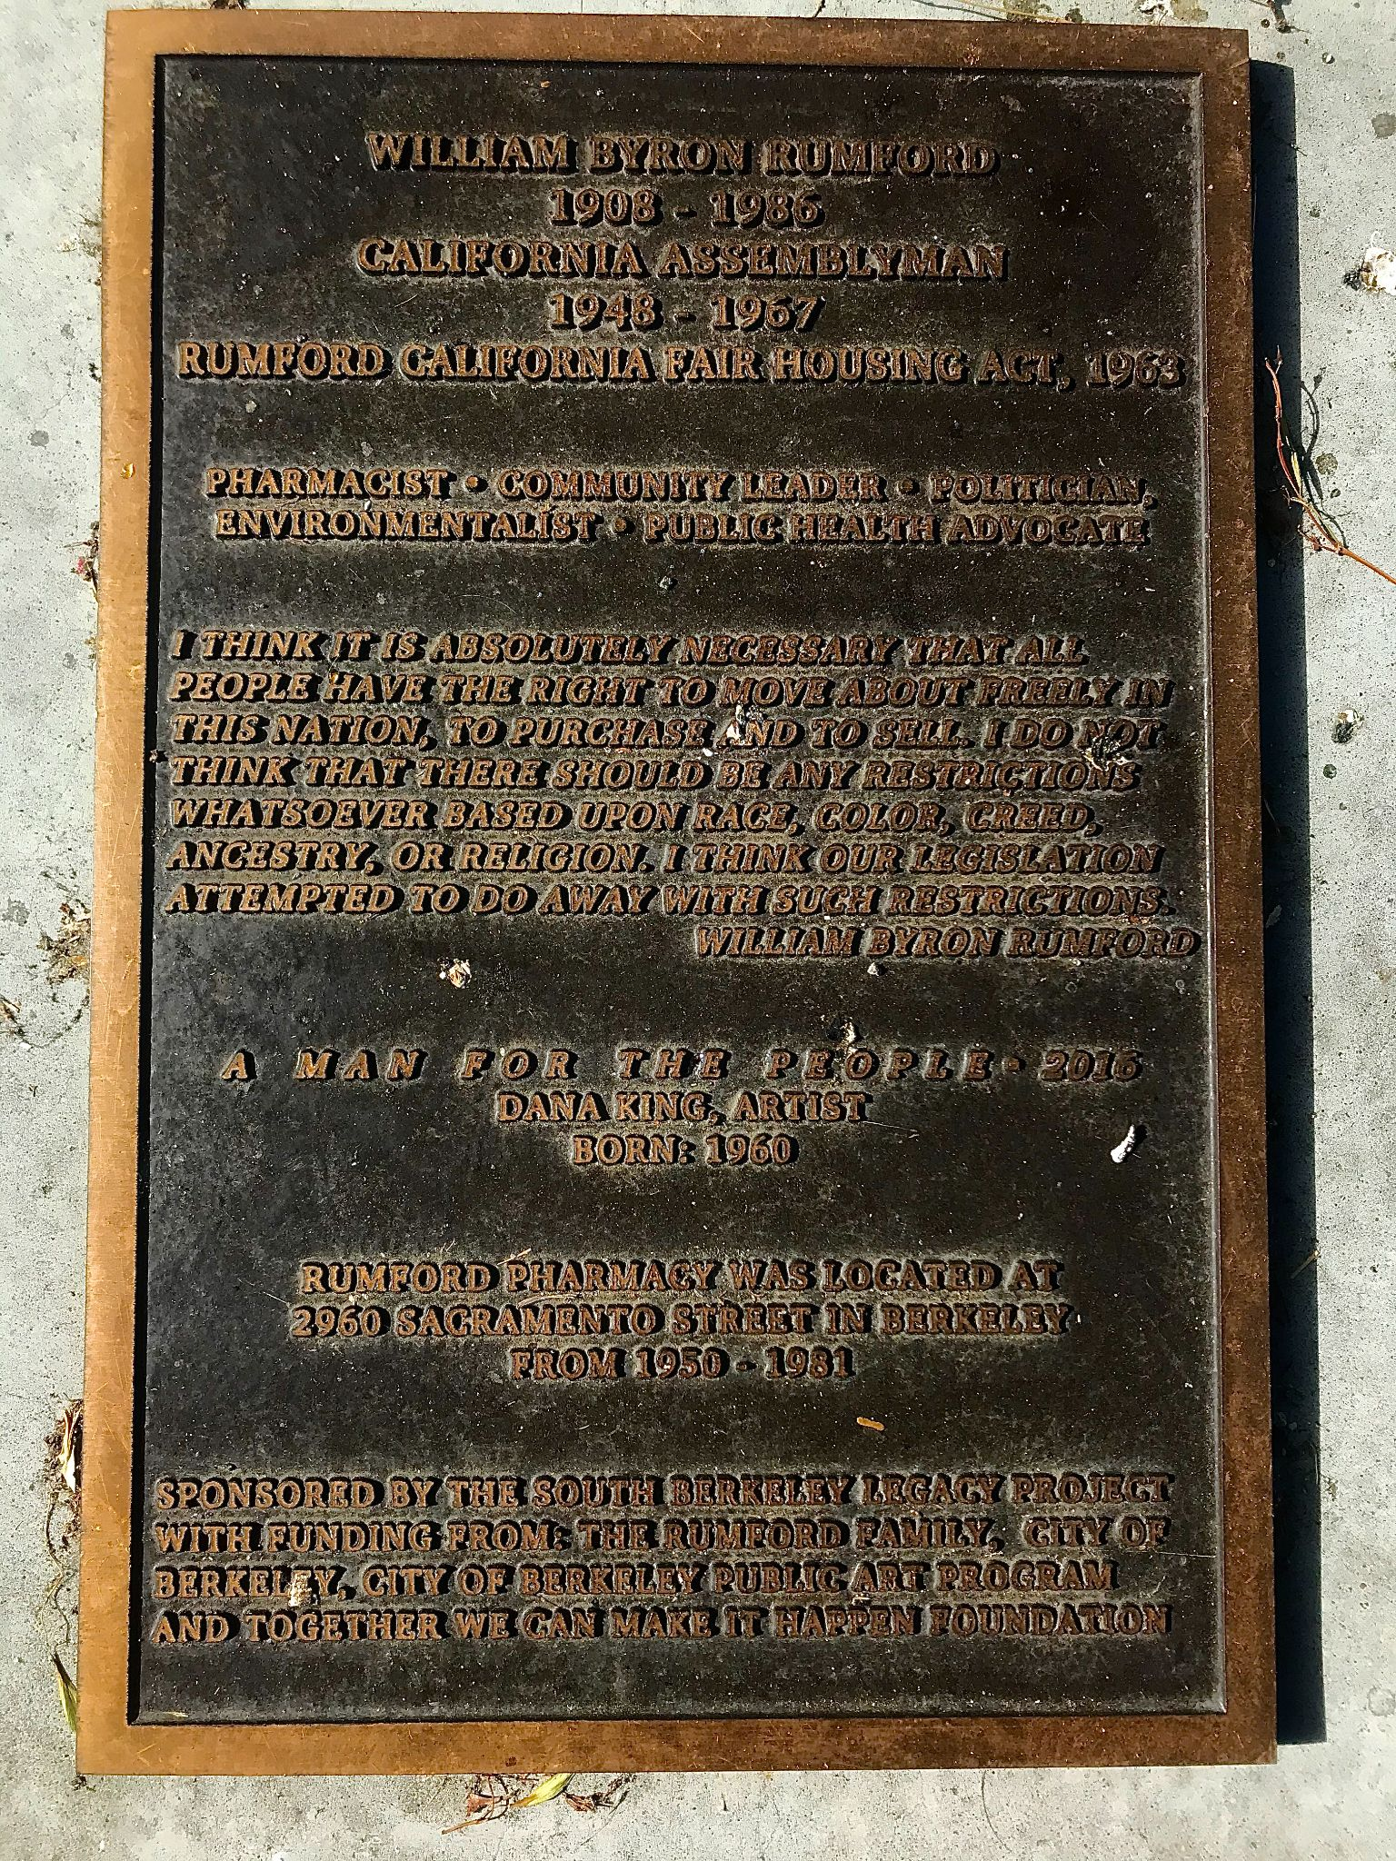
This top photo shows the statue of William Byron Rumford. The image underneath is simply the placard outlining what he did for the people of his community and state. It is hard to miss this statue while on this portion of Sacramento St. This stands just a block north of Ashby Ave.
The placard identifies Rumford as “pharmacist, community leader, politician, environmentalist, and public health advocate.”
He was a major person for the black community in this area, especially during the late 50s to the early 70s.
An archival image a flyer promoting Rumford talking about A Fair Housing Law in California. The discrimination for housing in California, like many other places, was relatively brutal if you didn’t have whiteness or wealth to uplift your chances of having access to good loans or choice in where you wanted to live. Provided by the National Association for the Advancement of Colored People, San Francisco, California Branch, sponsor. 1963 March 22

Slide 11
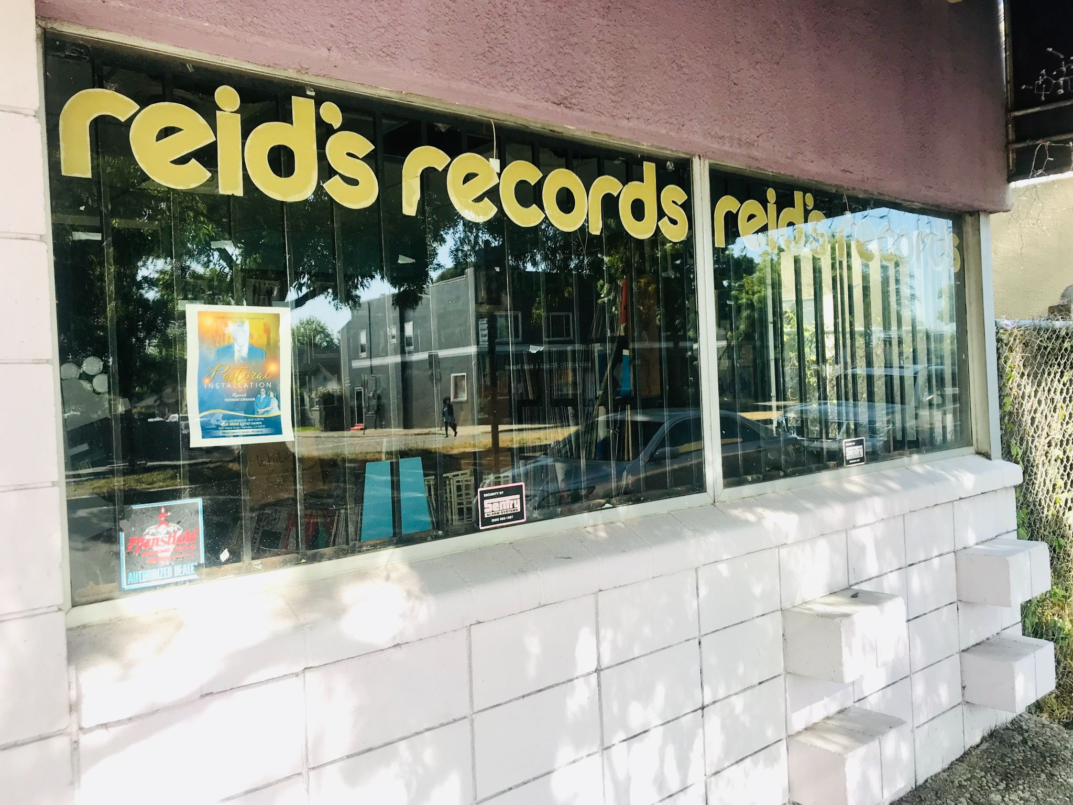
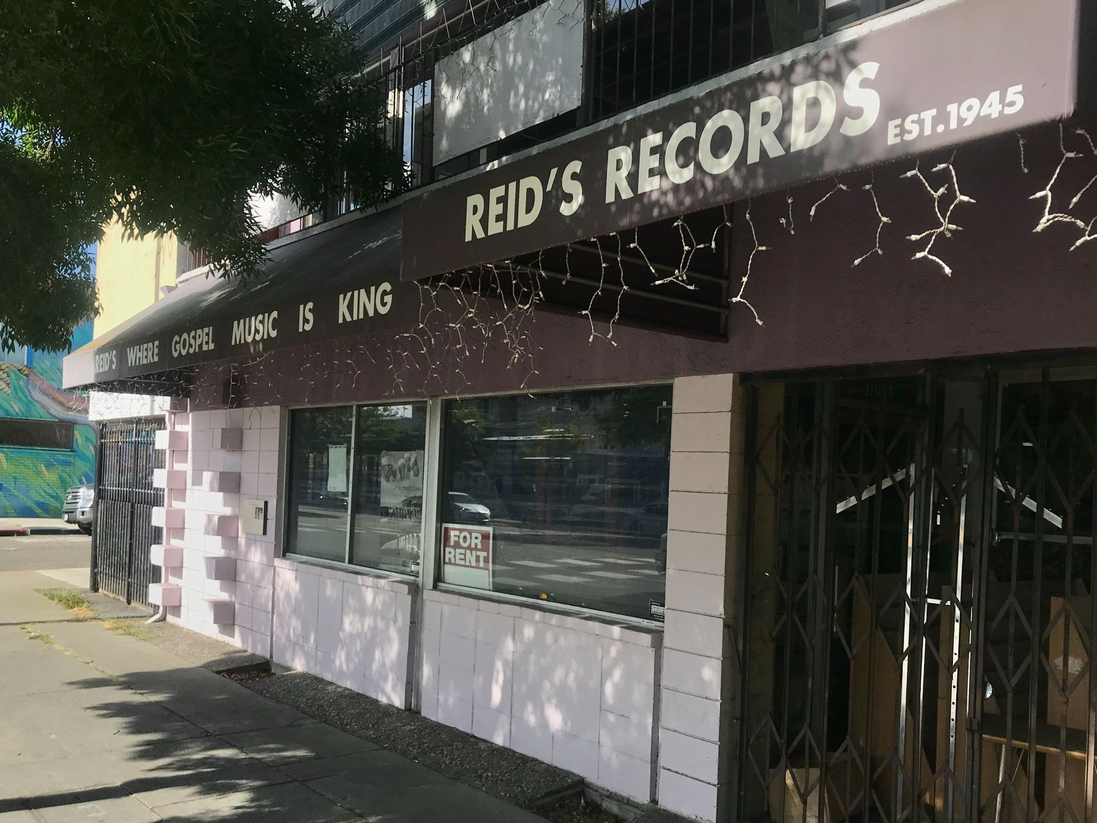
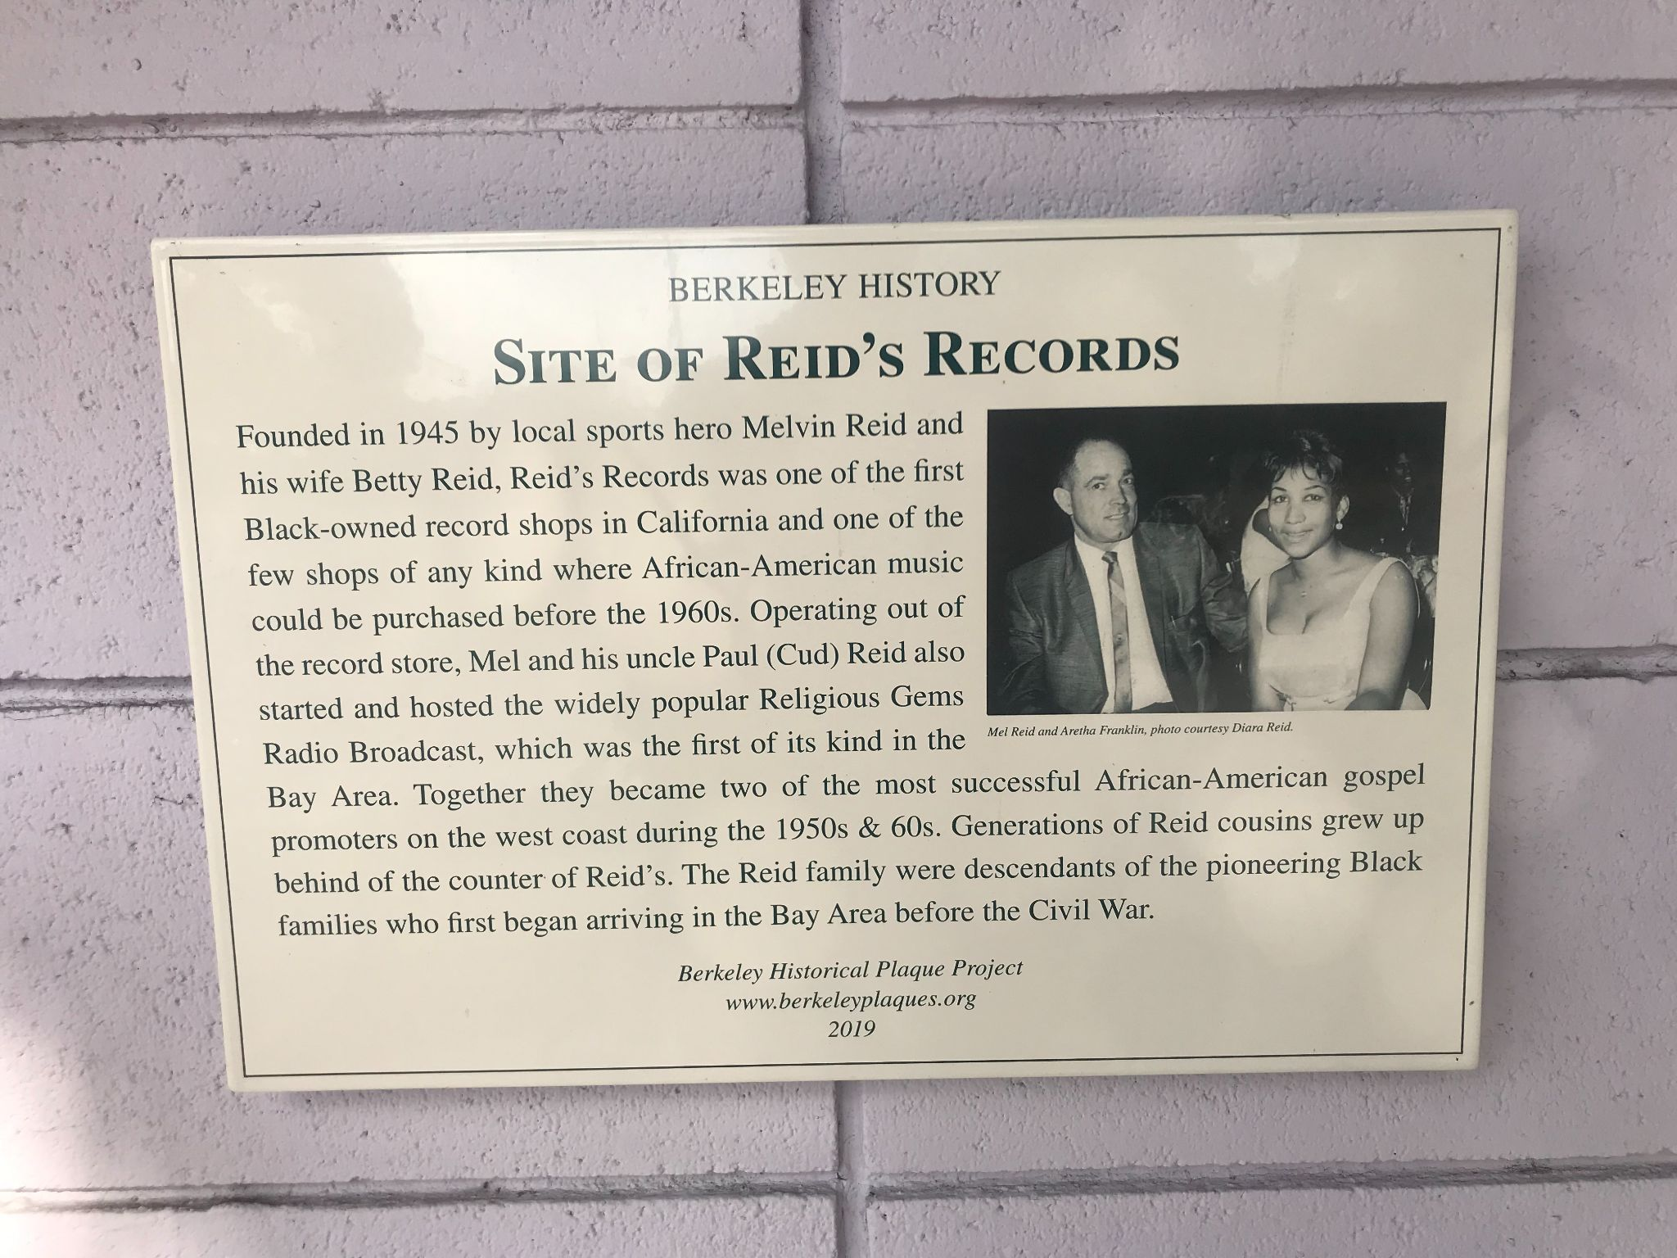
This is the building that housed Reid Records since 1945. In the picture on the top you can see a for rent sign in the windowsill in you focus your attention.While the business of Reid Records is no more, it played a fundamental role for black people in this neighborhood (Soskin, 2018). They sold African American artists pretty exclusively and then later transition the shop's focus on gospel music (Soskin 2018). Fortunately, the name of the record shop is still there and if you try to look inside of the window in the top left image you may be able to notice that there are still records inside of the building. The bottom photo of this triad show a picture of Mel Reid (the owner of the record shop) with the beautiful and talented Aretha Franklin. Not only was Reid Records recognized and loved locally, but it had the attention of folks who didn’t necessarily belong to this community or neighborhood in South Berkeley.

Slide 12
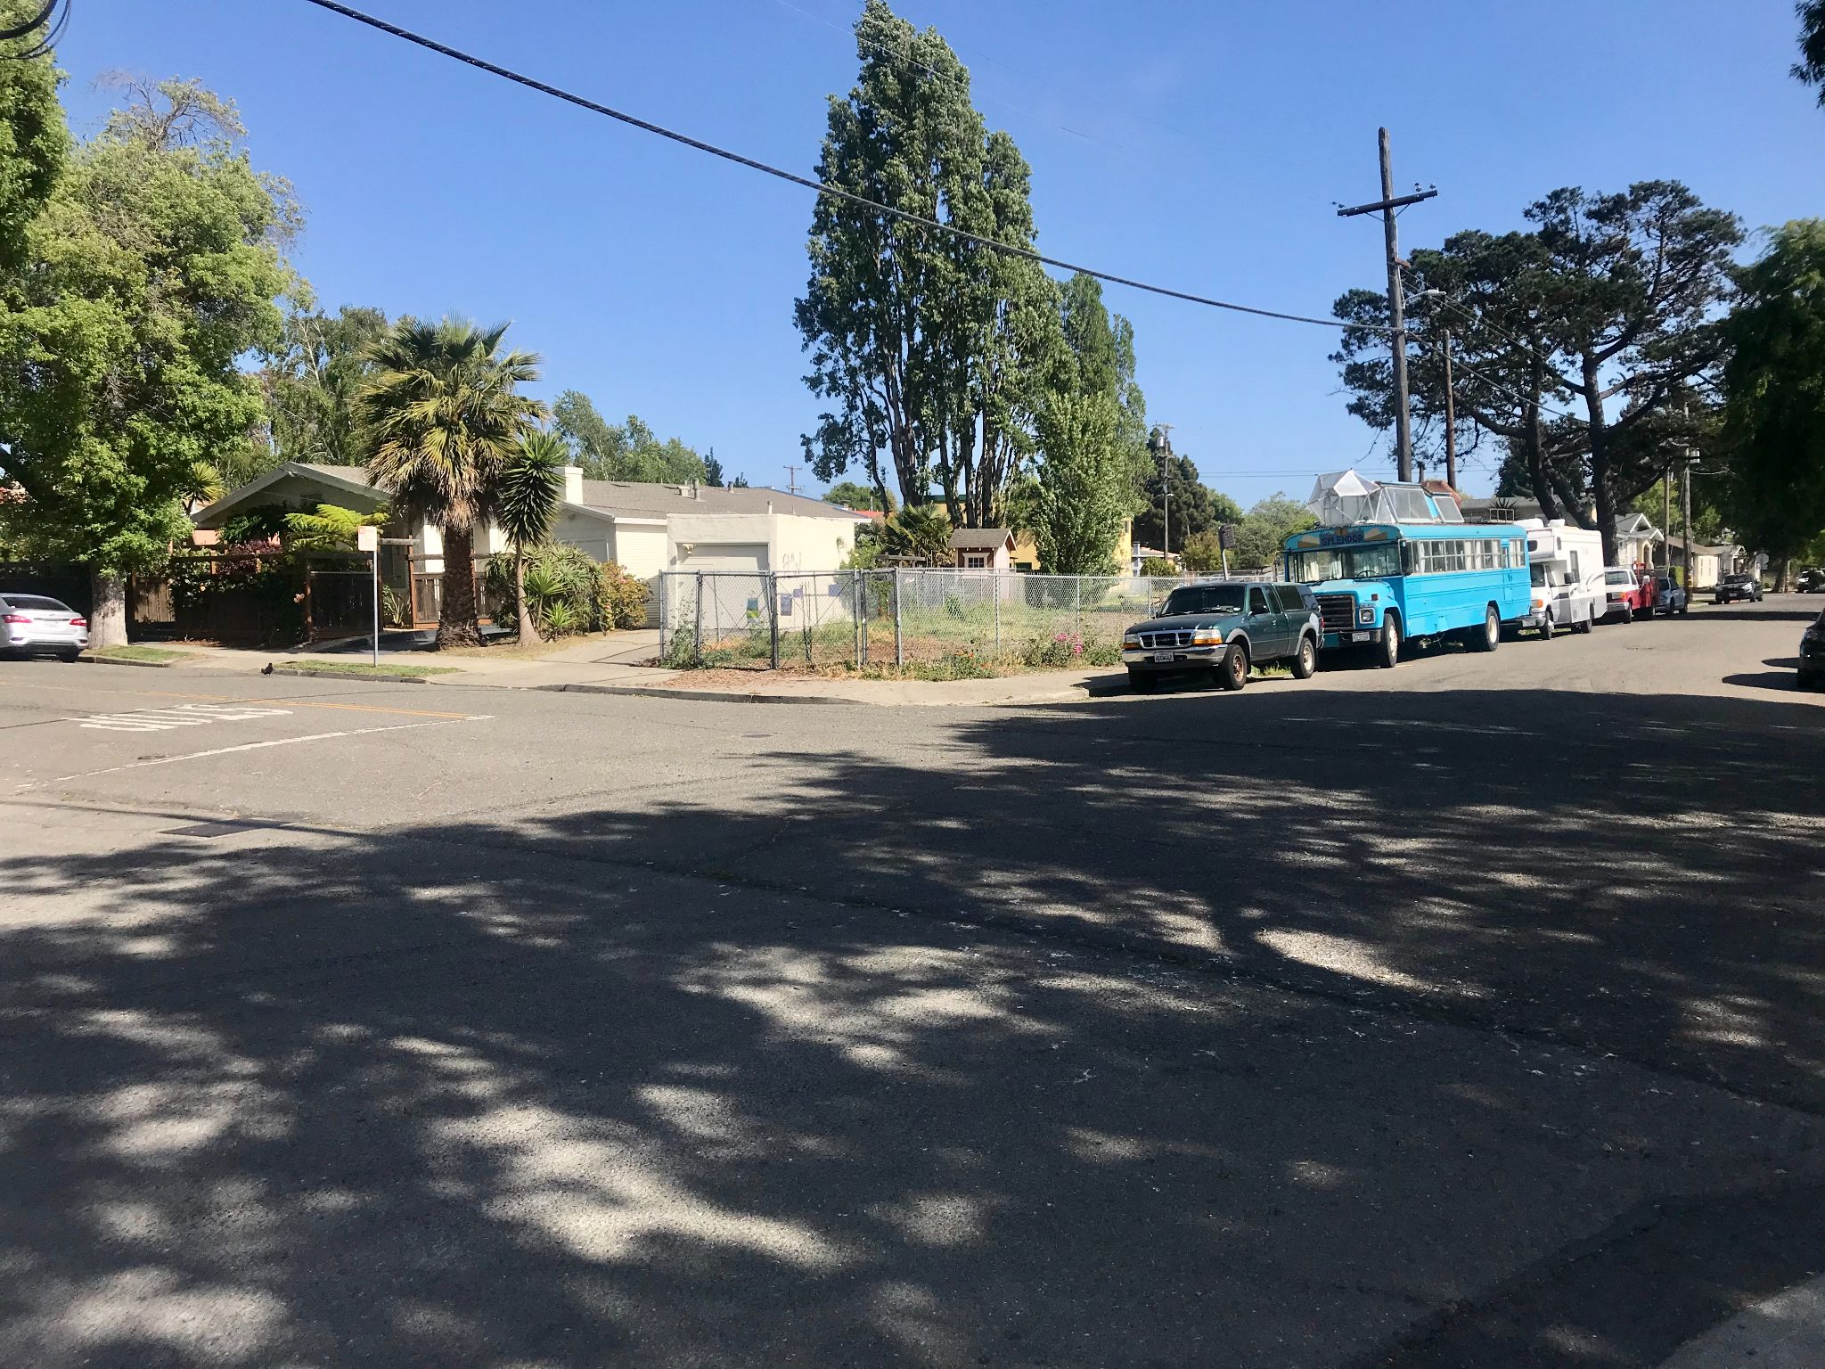
This is the intersection of Acton St. and Parker St. in the south Berkeley neighborhood that I surveyed. In looking straight ahead at the fence that is enclosing a plot of land you are looking at the course of the old Santa Fe Railroad line that used to run right through this neighborhood. This was a massive, industrial mechanism that came through this exact area! The diagonal plots of land, like the one you are viewing, that start at the intersection Acton St. and Dwight Way and travel all the way up to Sacramento St. give us a distinct sign of the flows of industry and people through this neighborhood during the mid-19th century (i.e. early 40’s to mid-60s). While this looks like any old picture of a neighborhood it provides us with so much history – all in one image.

Slide 13
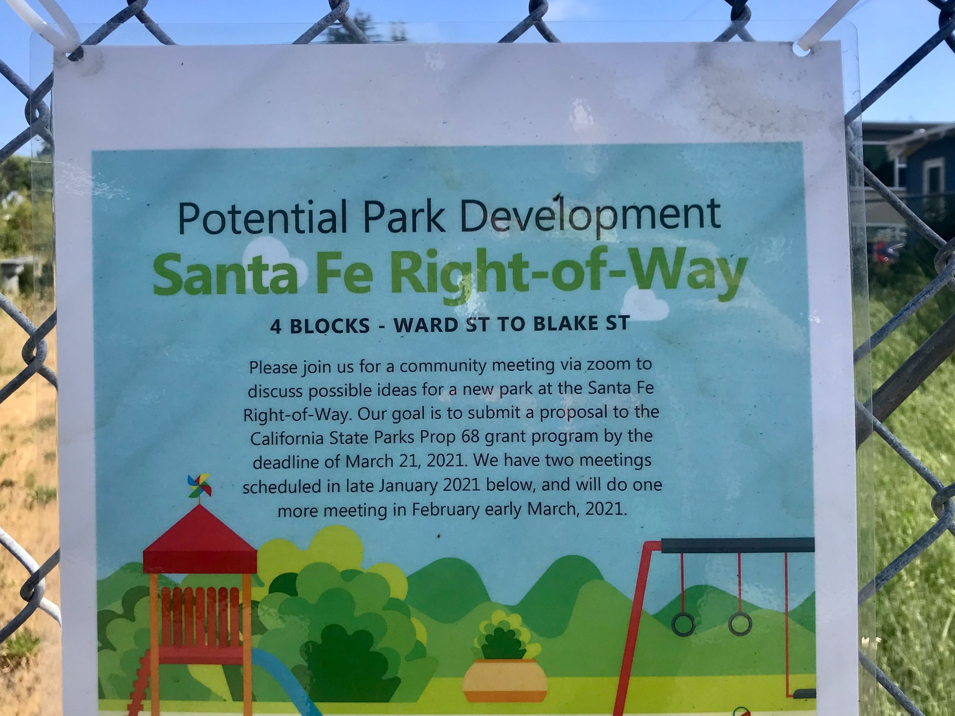
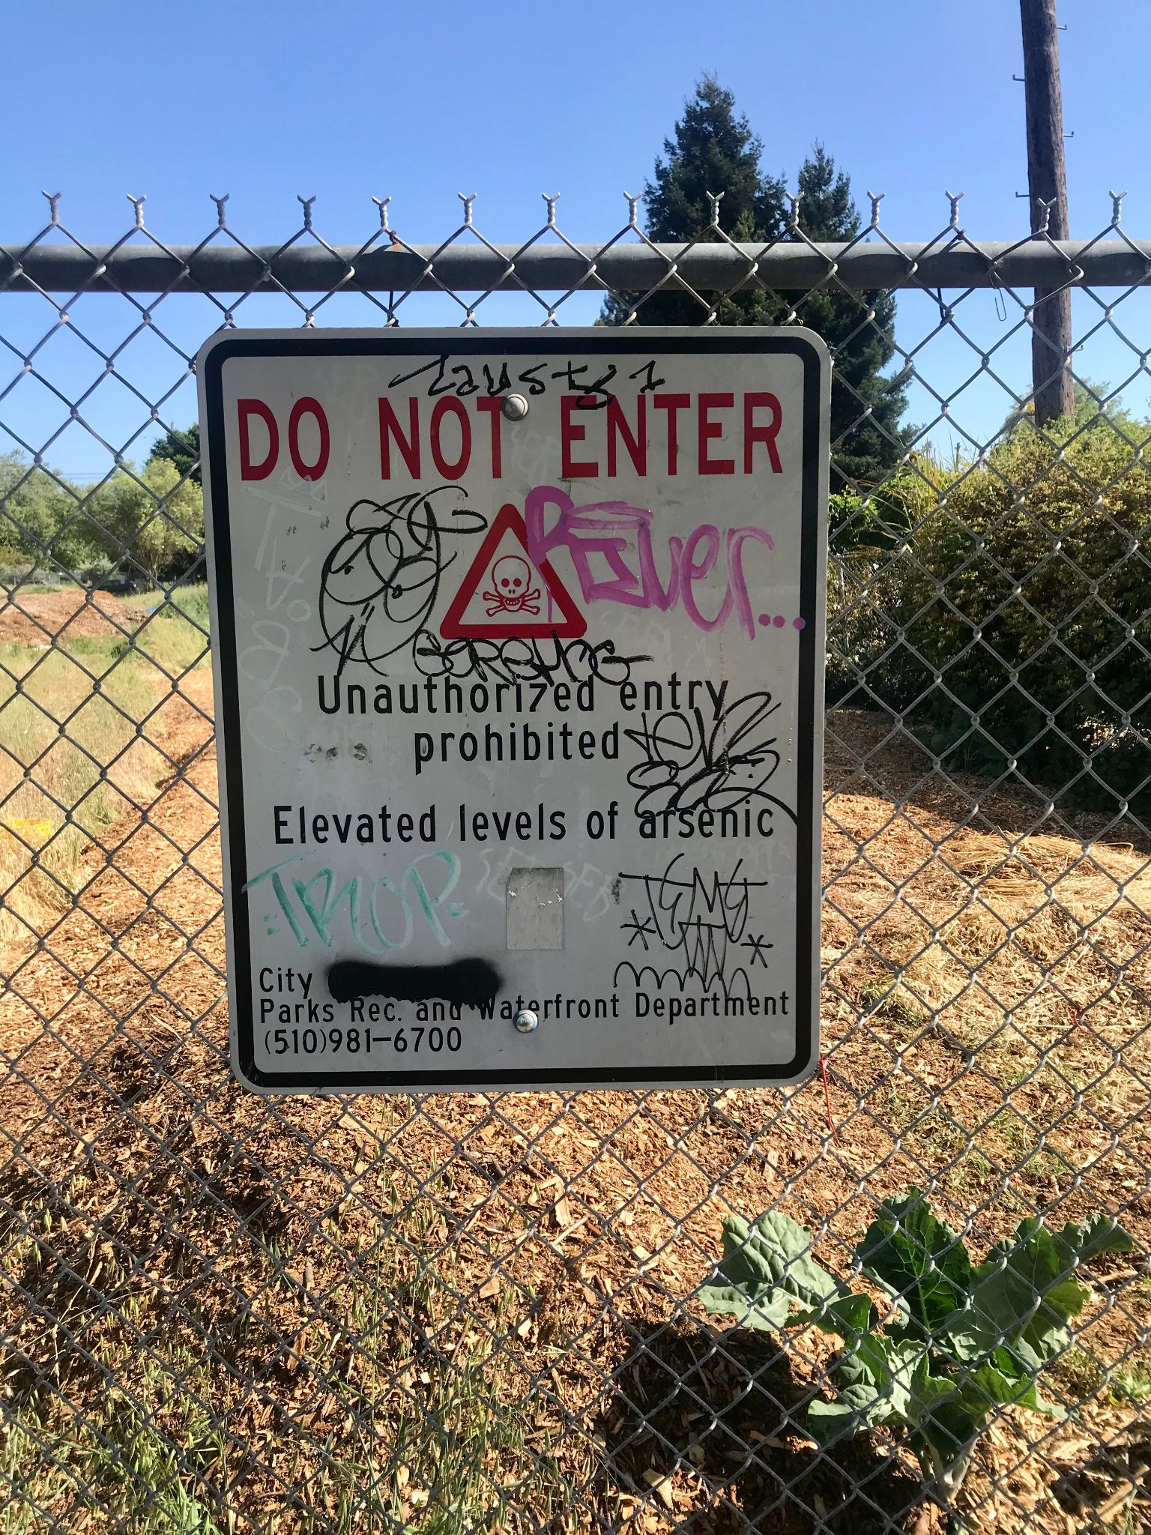
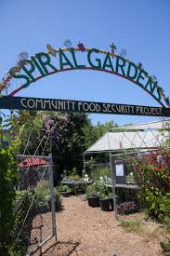
These are images of signs that were found outside of a toxic plot of land of Carleton St., half a block up from Acton St. The image on the button notifies the public that this is not a site that you want to enter just yet as it has poisonous toxins in the ground. Remember the Santa Fe Railroad line used to run right through here, as while it brought many people to this area it also brought many dangerous pollutants that had cause some people in the area to go ill (Danny Sylvester in conversation in July 2020). The image on top is trying to reimagine and potentially develop on these toxic sites, restoring them and having them available for public use. Much brainstorming has been around the development community gardens (Woods 2020).
The last image of today is that of Spiral Gardens which is located on Sacremento St. two blocks north of Ashby Ave. This project got started 1993 and had tried to help make the community become more food secure. As time progresses forward there is a lot of movement towards making this neighborhood a more green and connected one after it’s incredibly industrious and segregated history!
THANKS FOR JOINING! I HOPE THIS WAS ADDITIVE TO YOUR DAY AND KNOWLEDGE OF THE SOUTH BERKELEY NEIGHBORHOOD!
PEACE AND BE WELL – HAVE A BLESSED DAY!

